Slide 1

18CSC202J - OBJECT ORIENTED DESIGN AND PROGRAMMING
Session 1
Topic : PROCEDURAL AND OBJECT ORIENTED PROGRAMMING

Slide 2
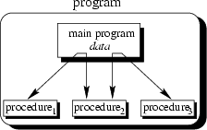
The main program coordinates calls to procedures and hands over appropriate data as parameters.

Slide 3
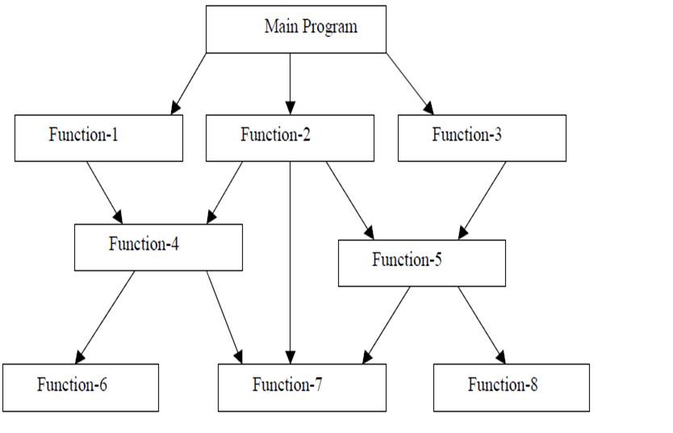
Procedure Oriented Programming Language

Slide 4
C function aspects | Syntax
Function declaration | Return-type function-name(argument list); Eg : int add(int a, int b);
Function definition | Return-type function-name(argument list) { body of function;) Eg : int add(int a, int b) {int c; c=a+b; Return c; }
Function call | Function-name(argument list); Eg : add(5,10);

Slide 5
Features of Procedure Oriented Programming Language
Smaller programs - A program in a procedural language is a list of instructions.
Larger programs are divided in to smaller programs known as functions.
Each function has a clearly defined purpose and a
clearly defined interface to the other functions in the program.
Data is Global and shared by almost all the functions.
Employs Top Down approach in Program Design.

Slide 6
Examples of Procedure Oriented Programming Language
COBOL
FORTRAN
C

Slide 7
Sample COBOL Program(Procedure Oriented)
IDENTIFICATION DIVISION.
PROGRAM-ID.
ENVIRONMENT DIVISION. * procedure will be followed by using few Division
DATA DIVISION.
WORKING-STORAGE SECTION.
77 A PIC 9999.
77 B PIC 9999.
77 ANS PIC 999V99.
PROCEDURE DIVISION.
MAIN-PARA.
DISPLAY \”--------------------------------\”.
DISPLAY \” ENTER A\”
ACCEPT A. * command line argument
DISPLAY \”ENTER B\”.
ACCEPT B.
DISPLAY \”----------------------------------\”.
ADD-PARA.
ADD A B GIVING ANS.
DISPLAY \”-------------------------------------\”.
DISP-PARA.
DISPLAY \”A IS \” A.
DISPLAY \”B IS \” B.
DISPLAY \”ADDITION -\” ANS.
STOP RUN. * to stop the program

Slide 8
Disadvantages of Procedural Programming Language
Unrestricted access
functions have unrestricted access to global data.
Real-world modeling
unrelated (separated) functions and data, the basis of the procedural paradigm, provide a poor model of the real world.
Complex real-world objects have both attributes (data) and behavior (function).

Slide 9
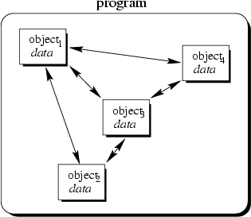
Object-Oriented Concept
Objects of the program interact by sending messages to each other, hence it increases the data security (data can be accessed only through its instances)

Slide 10
Object Oriented Programming
Object-oriented programming is a programming paradigm that uses abstraction in the form of classes and objects to create models based on the real world environment.
An object-oriented application uses a collection of objects, which communicate by passing messages to request services.
The aim of object-oriented programming is to try to increase the flexibility and maintainability of programs. Because programs created using an OO language are modular, they can be easier to develop, and simpler to understand after development

Slide 11
Object-Oriented Concepts
Everything is an object and each object has its own memory
Computation is performed by objects communicating with each other
Every object is an instance of a class. A class simply represents a grouping of similar objects, such as Integers or lists.
The class is the repository for behavior associated with an object. That is, that all objects that are instances of the same class can perform the same actions.
Classes are organized into a singly rooted tree structure, called the inheritance hierarchy. Memory and behavior associated with instances of a class are automatically available to any class associated with a descendant in this tree structure.

Slide 12
Object-Oriented Programming vs. Procedural Programming
Programs are made up of modules, which are parts of a program that can be coded and tested separately, and then assembled to form a complete program.
In procedural languages (i.e. C) these modules are procedures, where a procedure is a sequence of statements.
The design method used in procedural programming is called Top Down Design. This is where you start with a problem (procedure) and then systematically break the problem down into sub problems (sub procedures).

Slide 13
Object-Oriented Programming vs. Procedural Programming
The difficulties with Procedural Programming, is that software maintenance can be difficult and time consuming.
When changes are made to the main procedure (top), those changes can cascade to the sub procedures of main, and the sub-sub procedures and so on, where the change may impact all procedures in the pyramid.
Object oriented programming is meant to address the difficulties with procedural programming.

Slide 14
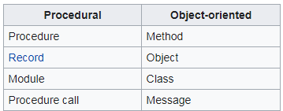
The main difference

Slide 15
Comparison
Procedural Oriented Object Oriented
Program is divided into small parts called ‘Functions’
Program is divided into small parts called ‘Objects’
Global and Local data
Has access specifiers : Public, Private, Protected
Doesn’t have any proper way for hiding data
Provides data hiding and security
Eg: C, VB, FORTAN Eg: C++, JAVA, VB.NET

Slide 16
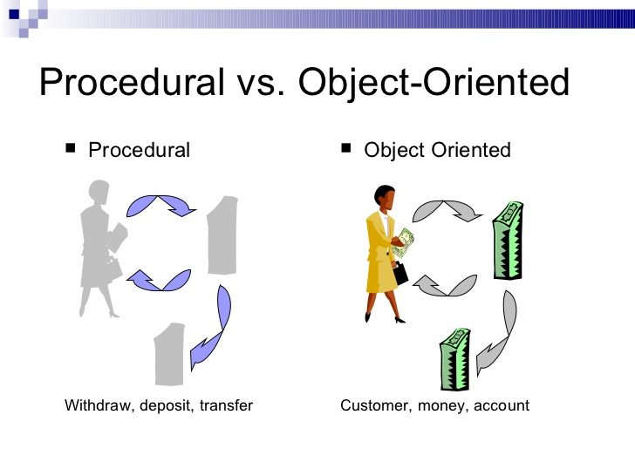
Comparison

